Slide 1

AI-Driven Public Safety Monitoring Through Pose Estimation and Activity Recognition
ITA0506 – COMPUTER VISION
Presentation By :
192421098 Monisha K
192425059 Monika P
192421221 Harshitha G S
192425217 T Chaitra
192321126 K.Meghana
192425249 K.Teja Sri
Program Director : Dr. Sasi Rekha, Prof/CSE
Faculty:- Mrs. R C Jeni Gracia, AP / CSE

Slide 2


Agenda
Introduction
Literature Review
Problem Statement
Objectives
System Architecture - Overall Design of Project
Modules Introduction

Slide 3
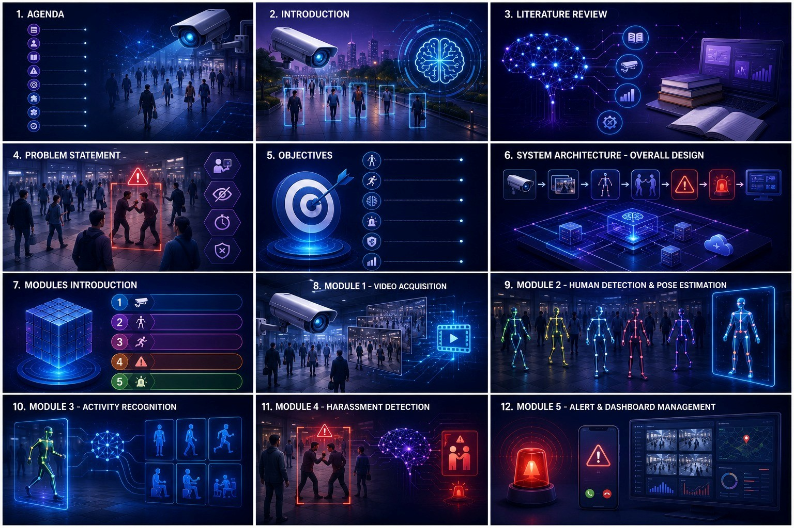
Introduction
Uses Artificial Intelligence to improve public safety.
Detects suspicious human interactions using CCTV footage.
Employs Pose Estimation to identify body movements.
Uses Activity Recognition to classify human behavior.
Generates real-time alerts for possible harassment.
Helps authorities respond quickly and improves women's safety.

Slide 4
Literature Review
S. No | Year | Paper Title | Method Used | Key Finding | Limitation
1 | 2025 | An Intelligent Crime Surveillance Video System for Real-Time Applications | YOLO, OpenPose, DeepSORT, LSTM | Detects violent activities in real time and generates alerts. | Focuses on violence rather than harassment detection.
2 | 2025 | Pose to Protect: Federated Skeleton-Based Anomaly Detection for Privacy-Conscious Video Surveillance | Pose Estimation + Federated Learning | Improves privacy-preserving anomaly detection in surveillance videos. | Detects anomalies, not specific harassment events.
3 | 2023 | Human Pose-Based Estimation, Tracking and Action Recognition with Deep Learning: A Survey | Deep Learning, Pose Estimation, Action Recognition | Reviews state-of-the-art techniques for pose estimation and activity recognition. | Survey paper; does not propose a detection system.
4 | 2022 | Pose is All You Need: Pose Only Group Activity Recognition System (POGARS) | Skeleton-Based Pose Recognition, CNN | Accurately recognizes group activities using only human poses. | Limited to activity recognition; not designed for harassment detection.

Slide 5
Problem Statement
Public harassment often goes unnoticed.
Continuous manual surveillance is difficult.
Conventional CCTV only records incidents.
Delayed detection reduces emergency response.
Need an AI system for automatic harassment detection and alerts.

Slide 6
Objectives
Detect human poses accurately.
Recognize suspicious activities.
Classify harassment events using AI.
Generate instant alerts.
Improve public safety.
Reduce manual monitoring.

Slide 7
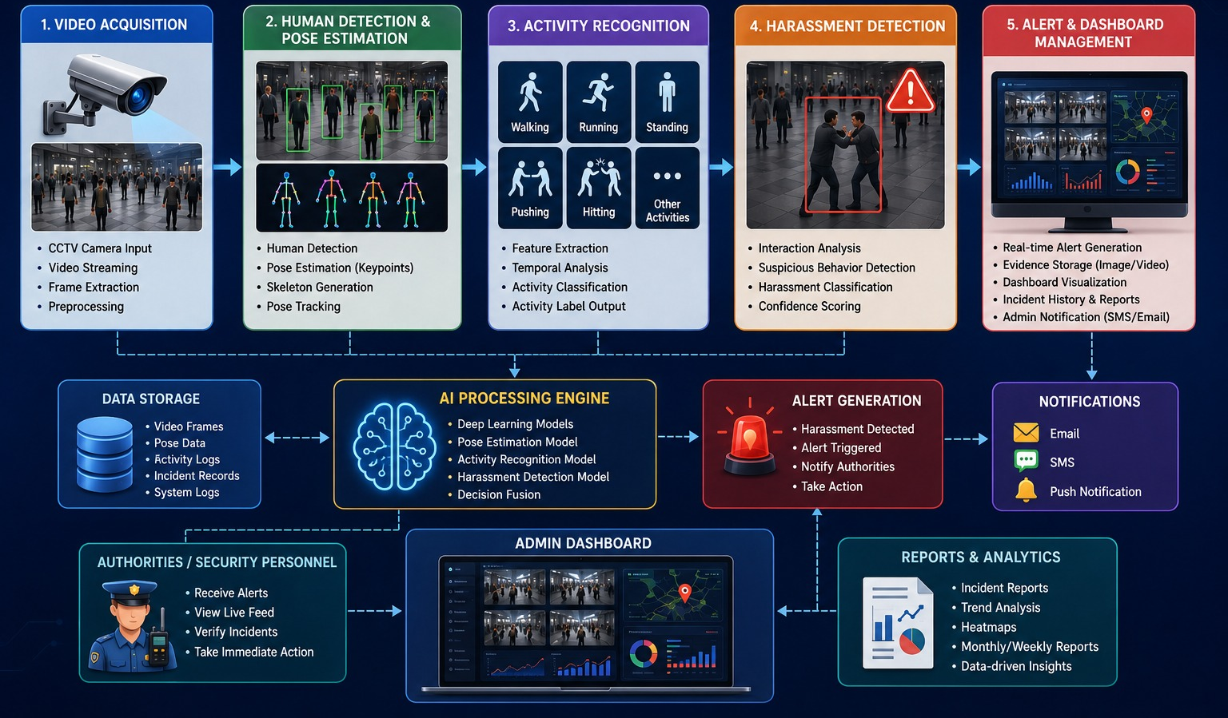
Architecture

Slide 8
Module 1 – Video Acquisition
.
Purpose: Collect live CCTV video.
Functions:
Camera initialization
Video streaming
Frame extraction
Frame preprocessing
Output: Video frames

Slide 9
Module 2 – Human Detection & Pose Estimation
Purpose: Detect humans and extract body key points.
Functions:
Person detection
Skeleton generation
Key point extraction
Pose tracking
Output: Human skeleton coordinates

Slide 10
Module 3 – Activity Recognition
Purpose: Recognize human actions.
Functions:
Analyze movement
Detect aggressive posture
Feature extraction
Behavior classification
Output: Error Explanation, Suggested Correction, Corrected Code, Programming Tips.

Slide 11
Module 4 – Harassment Detection
Purpose: Determine whether suspicious interaction is harassment.
Functions:
Analyze multiple persons
Detect physical aggression
Confidence scoring
Event classification
Output:
Harassment detected / Normal activity

Slide 12
Module 5 – Alert & Dashboard Management
Purpose: Notify authorities and display results.
Functions:
Generate alert
Save evidence
Update dashboard
Maintain event history
Output:
Alert notification
Incident report
Dashboard visualization

Slide 13

Thank You

